Slide 1
Allport model
Lesson-4-

Slide 2
Perspective of Consumer Behavior Field
Consumer behavior field is interdisciplinary in nature. Consumer behavior in most of the cases is a complex process. The decision process that the consumers undergo is shaped by broad social or cultural forces, close interactions with different people and organizations, as well as the personal characteristics of the individuals. To describe consumer behavior effectively, considerations of all of the perspectives including cultural, social, and individual influences are prerequisite.
Certainly, the most pervasive force on an individual is the cultural environment which is the complex set of values, ideas, attitudes, and other meaningful symbols created by people to shape human behavior. It also includes the artifacts (society’s material features) and the transmission of these values, ideas, attitudes, and the artifacts from one generation to the next. How people work and play, what they buy, how they buy them are affected by their cultures.
Human beings work and live with each other, and generally are influenced by some of the people around them. In particular, consumers are affected by their social class standing, reference group, and family. Their buying decisions are, as a result, influenced by these social influences. Although the cultural, social, and other influences can be very strong, so too are those within the individual. Needs and motives, learning processes, perceptions, personalities, self-concepts, and attitudes have a significant impact on what, how, why, and when people buy.

Slide 3
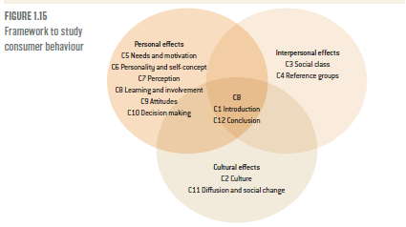

Slide 4
Approaches explaining consumer behavior
Consumer behavior field is studied using two types of theories – the traditional and the newer or contemporary/modern theories. The older or traditional theories were developed based on the opinions or intuitions of marketers.
The present day marketers use modern scientific theories in explaining what makes consumers behave as they do. The contemporary marketers also use models in explaining the unpredictable behavior of consumers.
The newer approaches are so precise that they have overshadowed the older traditional approaches of buyer behavior. The modern theories are interdisciplinary in nature since the subject consumer behavior itself is a multidisciplinary subject. The contemporary approaches are also accompanied by models to help marketers understand behavior more accurately.

Slide 5
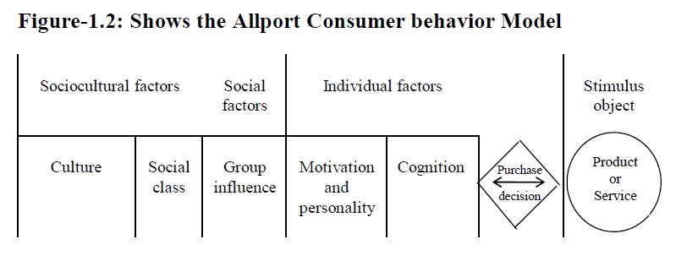
Allport consumer behavior model

Slide 6
Description of the Model
Allport consumer behavior model basically shows the relationship of socio-cultural, social, and individual factors with that of the stimulus objects relating to products or services. An individual’s consumption or purchase decision is the outcome of this interaction. The stimulus objects relating to the product or service continuously interact with these three sets of factors. The result of the interaction is the decision of the buyer. If the result of interaction is positive, the buyer will decide to buy the brand, and, if the result is negative, he will forego the idea of buying the brand whose stimuli he considered.

Slide 7
• Socio-Cultural Factors and Their Influences on Buying:
What products you buy, the way you use them, the frequency with which you buy and use them, and even the methods you apply to buy them all are determined by the cultural context of which you are a part. (Drinking juice on breakfast)
With regards to the method of buying, self-service is preferred by people of certain cultures, where in our culture it is not still found to be a common practice. Bargaining is preferred here in our culture, where it is not a practice in other cultures. In our country, we test the freshness of fish by pressing it through our fingers, or slapping on a watermelon, where it cannot be imagined in a modern developed culture.
Marketing now a days no more considered a local or national phenomenon, rather a multinational phenomenon. The cheese that is produced in South of France, may have markets well beyond its national boundary. In order to be successful, marketers therefore, should have idea on other cultures in addition to his own if he plans to market his products elsewhere.

Slide 8
• Socio-Cultural Factors and Their Influences on Buying:
Cultural traits are not same everywhere. There is great diversity found among cultures. Certain cultures are characterized by value shifts and technological change (such as western cultures), where others are characterized by insularity and tradition (such as Bangladesh culture). These differences affect the products and services people buy. Because of relaxed sexual mores certain products have very good markets in western cultures, where in a traditional culture these products cannot be sold and advertised publicly. The values retained by cultures are not rigid rather they change over time. Even in a country like Lebanon values have changed significantly over last couple of decades bringing substantial changes in our consumption behavior.
There are often subcultures within a culture, adding to the complexity of cultural influence on consumer behavior. Just as there are unique market segments within a more generally defined market, there are also diversities within a culture. Undoubtedly, differences exist on the basis of region, religion, age, income, family structures and so on.

Slide 9
Social Factors and Their Influences on Purchase/Consumption
Human beings work and live with each other, and generally are influenced by some of the people around them. In particular, consumers are affected by their social class, reference group, and family. The influences of these social factors are just as pervasive as the cultural factors.
People belonging to a particular social class tend to have similar beliefs, life styles and buying patterns. They purchase similar products from same stores, and live in the same types of neighborhoods and houses. People conform to patterns of living and buying accepted by the other members. Although lifestyles are quite similar within a social class, they vary considerably from class to class.

Slide 10
Social Factors and Their Influences on Purchase/Consumption
Consumers can belong to a variety of reference groups. A reference group is a group of people with whom the individual looks to for association, information, and standards of behavior. These groups can be formed on many bases, including family, work, professional, religion, educational, and recreational. These groups exert tremendous and widespread impact on consumer buying behavior. It is quite possible for reference groups to influence both the type of product purchased and the brand name selected.
The family usually is the most significant group for the consumer, exerting a stronger and more wide ranging influence on lifestyles and purchasing behavior than any other. Decision making in the family and the influence of a particular member in such decision depends on the product or service in question. Certain decisions are made individually by a particular member, while others are taken collectively. It varies according to the type of the product as well as the stage of the life cycle where the family fits. (Newly married couples, singles,…)

Slide 11
• Individual Factors and Their Influences on Buying/Consumption
The individual consumer variables are as equally important as the cultural and social forces on purchase/consumption decision. Every individual is a unique entity though he is a part of culture and different social groups. Thus, number of individual consumer variables come into action while the person contemplates a purchase decision.
Consumer decisions are influenced by his previous experiences that determine his learning. If you were dissatisfied with a particular brand, this experience will definitely shape your future decisions. In fact, aside from the instinctive needs, all needs are learned from past experiences and other individuals or groups, as well as the manners in which they seek to satisfy them. The learning theories suggest that marketers should increase the intensity of their stimuli including advertisements for learning to occur quickly.
Although consumers have many needs that are basically similar, they try to satisfy them in quite different ways, depending on how they perceive both their needs and the environment in which they operate. In fact, two people with identical needs may take different actions to fulfill them based on their perceptions of the situation. Since people perceive differently as well as selectively, stimuli that marketers give to markets should be different for different groups of people. The selectivity of perception suggests that advertisements and other stimuli offered by marketers should be outstanding for ensuring perception of his target markets.

Slide 12
• Individual Factors and Their Influences on Buying/Consumption
At the very center of a consumer’s buying decision is his or her physiological and psychological/social motives. A motive is a force, which has been activated into a state of tension causing the individual to seek to satisfy a specific need. Since motives vary from person to person so their behaviors vary. Some are motivated by price where others are by quality, still others by features of the product and a wide range of other factors. If marketers conduct motivation research it may help them revealing hidden consumers’ motives and the findings may be utilized to devise marketing strategies.
Personality of consumers is another individual factor determines behavior. Each consumer is unique in terms of his or her ambitiousness, conservatism/ liberalism, degree of extroversion, and so on. Collectively, these primary character traits comprise the individual personality. Personality pattern determines the type of product an individual will select and the style he will prefer. Why some people buy sports cars and why others do not even if they can afford? The simple answer is the differences in their personalities.

Slide 13
• Individual Factors and Their Influences on Buying/Consumption
Marketing executive, without question, must be concerned with consumer attitudes. They are an individual’s enduring favorable or unfavorable evaluations, emotional feelings, and action tendencies toward some object or idea. If attitudes toward the firm’s goods are favorable, information about the particular product or service is more likely to be received and have positive impact on consumers. If, for example, you like a particular singer’s style (having positive attitude toward him/her), you are likely to buy any new album released of that singer. If the attitudes are negative, that will also affect your decision, and it is very difficult to change attitude from a negative to a positive one.
In each buying decision, a consumer thus considers a unique set of social, cultural, and individual factors. They remain active throughout and interact with that of the marketer dominated activities through which they (marketers) try to influence people to buy their products. The purchase decisions are, thus, affected by this interaction as well as media and interpersonal communications.

